Slide 1
Up and Coming Video Games
Team: Zubair Aslam, Eva Fuentes-Lopez, Ammad Rashid, Karyssa Tillis

Slide 2
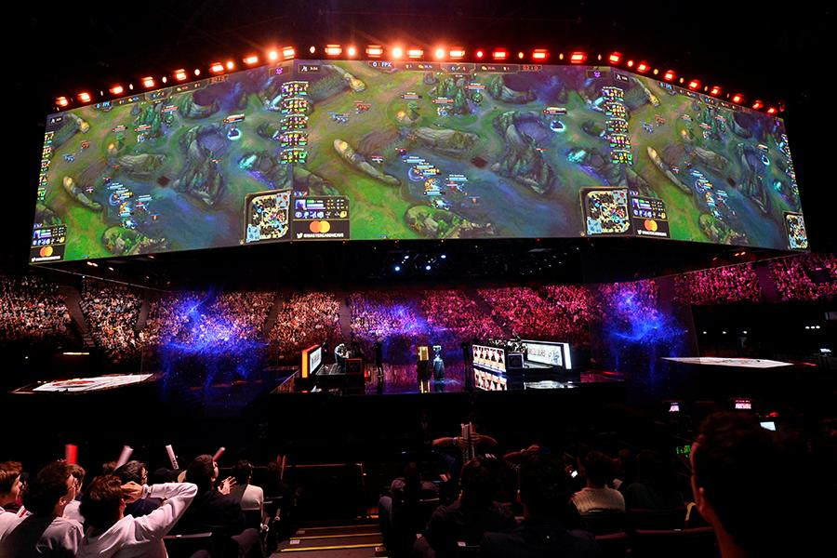
Topic Discovery
We began exploring project topics with eSports, for there was a lot of data available within the video game industry.
As we explored different areas, we came upon the questions of how did video games get so big? The industry has grown exponentially and there are many types of games available.
League of Legends (LOL) World Championship Finals in Paris, France, November 10, 2019.
Notes:
Speaker Notes:
We started with the topic of eSports since there was a lot of data coming from the video game industry in general.
Wikipedia Definition (For those that don’t know): Esports (also known as electronic sports, e-sports, or eSports) is a form of sport competition using video games. Esports often takes the form of organized, multiplayer video game competitions, particularly between professional players, individually or as teams.
As we explored different areas, we found a lot of data sets available to us and further narrowed down the idea of wondering out of everything, what made video games so popular? Since it has grown over decades and there are so many types available, and has statistics similar to everyday sports league and the like.
Image source:
Chinadaily.com.cn
https://www.chinadaily.com.cn/a/202001/07/WS5e13bce6a310cf3e35582c90.html
Caption: Team G2 Esports battle against FunPlus Phoenix during the first game of the League of Legends (LOL) World Championship Finals in Paris, France, November 10, 2019. [Photo/Agencies]

Slide 3

Topic Selection
Our topic was further narrowed down to figuring out what makes a video game popular. There are many features to focus on, such as the platform, type of game-play, genre, and various other categories.
By analyzing this data, it would help potential clients pick which creators to support, or help with decisions among their own creative teams to create a successful and popular video game.
Platform devices/controllers from left:
Nintendo Switch, Playstation 4, Xbox One, Personal Gaming Computer
Notes:
Speaker Notes:
The topic was further narrowed down to figuring out what makes a popular video game that many people would play. There are many features that are available to the consumers, and various platforms to choose from.
This data would help potential clients pick which creators to support, or help with decisions among their own creative teams to create a successful and popular video game.
Image Source: BagoGames.com
https://bagogames.com/different-types-of-gaming/

Slide 4

Data Exploration
We discovered a lot of available data sources, but a promising one was the Steam service, which has a library of nearly 30,000 games of their own make and from third-party publishers.
Many open datasets from Steam are available on Kaggle to choose and work with.
Notes:
Speaker Notes:
Discovered a lot of available data sources, but a promising one was the Steam service, which has a library of nearly 30,000 games available and many datasets on Kaggle to choose and work with.
Wikipedia Definition: Steam is a video game digital distribution service by Valve. It was launched as a standalone software client in September 2003 as a way for Valve to provide automatic updates for their games, and expanded to include games from third-party publishers.
Using Steam library data, we wanted to determine what makes a video game successful or “popular” to players, and to predict what next type of video game to meet that standard.
Image Source: https://store.steampowered.com/

Slide 5
Data Sources
Steam Store Games (Clean dataset)
Combined data of 27,000 games scraped from Steam and SteamSpy APIs (May 2019)
Creator: Nik Davis
Steam Games Complete Dataset
40k Steam Games Dataset from Steam shop with detailed data. (June 2019)
Creator: Alexander Antonov
Notes:
Speaker Notes:
We settled on two datasets from Kaggle that were sourced from Steam. The creators of both of these had their data scraped from Steam's shop and APIs and provided clean detailed data to work with.
These sets were published May 2019, but the Steam library has available APIs that can be scraped again to update the data set for future analysis.
*** Links to Kaggle data sources included in the titles.

Slide 6
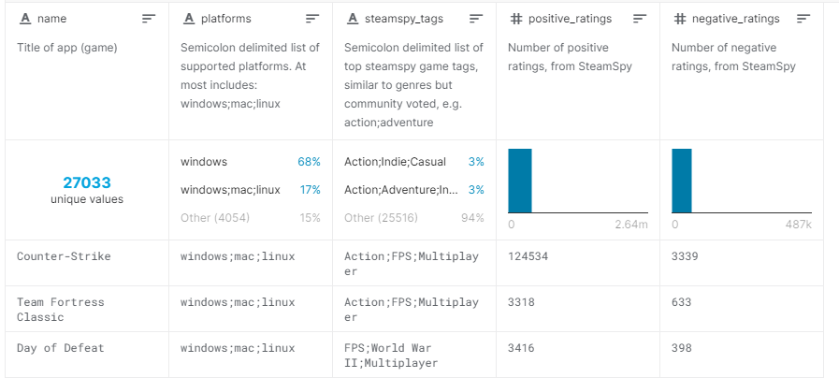
Focused columns from Steam Store Games (Clean dataset), 5 out of 18 columns displayed.
Notes:
Speaker Notes:
From the first data set, we focused on the displayed columns.
Positive Ratings = number of players that left a positive or “thumbs up” for the game.
Negative Ratings = number of players that left a negative or “thumbs down” for the game.
27,033 games in the set.
*** Screenshot of columns from Kaggle.com

Slide 7
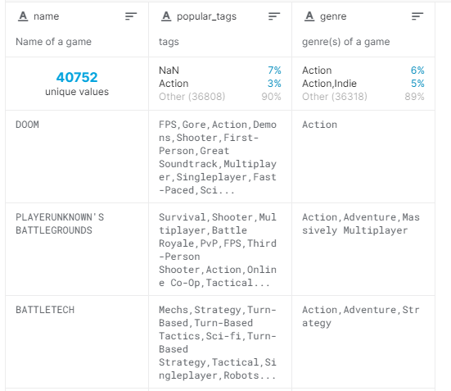
Focused columns from Steam Games Complete Dataset, 3 out of 20 columns displayed.
Notes:
Speaker Notes:
From the second data set, we utilized the Popular Tags and Genres that were assigned to the available games.
Popular tags were assigned to each game by the players to further classify the content that the game offered.
Genre is a more general classification of a play style of a video game.
40,752 games in the set.
*** Screenshot of columns from Kaggle.com

Slide 8
Questions to Answer
What features determine a video game’s popularity or success?
What relations are there between a game’s rating and genre or popular tags?
Notes:
Speaker Notes:
These are the following questions we decided to focus on as we examined our data sets and began our analysis.

Slide 9
Data Analysis
Determined the following aspects to focus on from our data sources:
PC based video games
Popular Tags
Genre
Ratings
Combined both data sets based on name and reduced outliers by eliminating the following:
Low rating counts
Low counts of miscellaneous Popular Tags
Low counts of Genre categories
Notes:
Speaker Notes:
We discovered a lot of titles and available game types within the data sets, but decided to focus on PC games to keep things a bit more streamlined and since there are a lot of creators who make games for the PC platform and therefore allows for a broader variety of genres/categories.
As each source was reviewed, we determined that we wanted to focus on the ratings of the game to generate a target, and the following attributes that may have contributed to the popularity or successfulness of the game.
The features we wanted to work with were genre and popular tags.

Slide 10
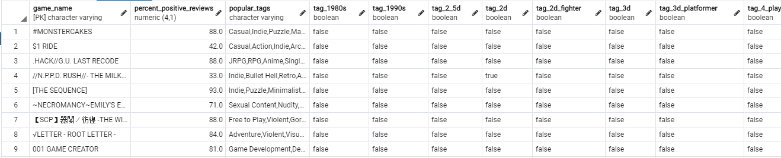
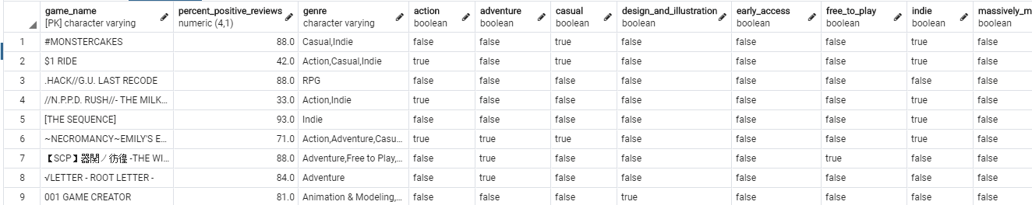
Cleaned Data Sets stored in PostgreSQL database.
Top Sample - Popular Tags data set
Below Sample - Genres data set
Notes:
Speaker Notes:
Created two cleaned separate data sets: one with columns made from each game's genre, and the other with popular tags for columns. Each had the respective game name and popularity rating.
Imported both into PostgreSQL.
Performed the following cleaning with Python, using Pandas libraries in Jupyter Notebook to further narrow down our dataset and Excel to pick up miscellaneous rows when importing to PostgreSQL:
Filtered down to only PC Games.
Narrowed down number of popular tag and genre columns with sum counts of less than 100 to eliminate the obscure/less used tags. Reduced miscellaneous games.
Narrowed down number of games with positive votes of less than 100. (Meaning less than 100 players have enjoyed the game, or the game had not garnered much popularity/interest since not a lot of users played it.)
Using both the Positive and Negative Ratings, we created an average rating for the game with a score out of 100 for the available games. The raw data also gave us a look into how many players have played said game by the number of positive and negative votes given.
This gave us 6,188 results (rows of games), to assist in narrowing our focus and to explore with different machine learning models.

Slide 11
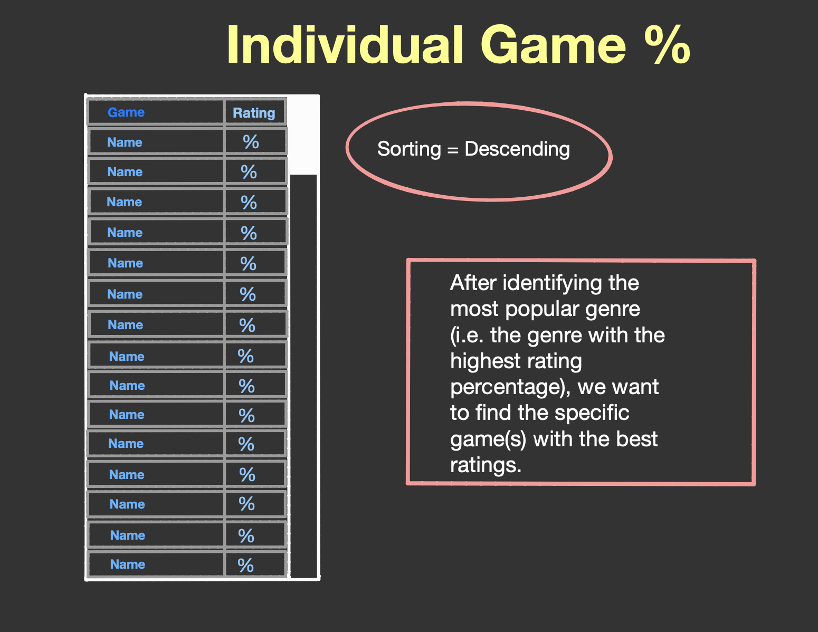
Data Analysis
Using individual ratings answered a simple question: What games were rated the most popular?
This opened up our next steps to determine the counts of games that fell into different rating brackets.
Notes:
Speaker Notes:
Using Tableau, we created the following visuals to further our analysis.
Basic question answered is what were the games that were rated the highest based on average rating. Created a simple bar chart/list to show the top games and their average rating.

Slide 12
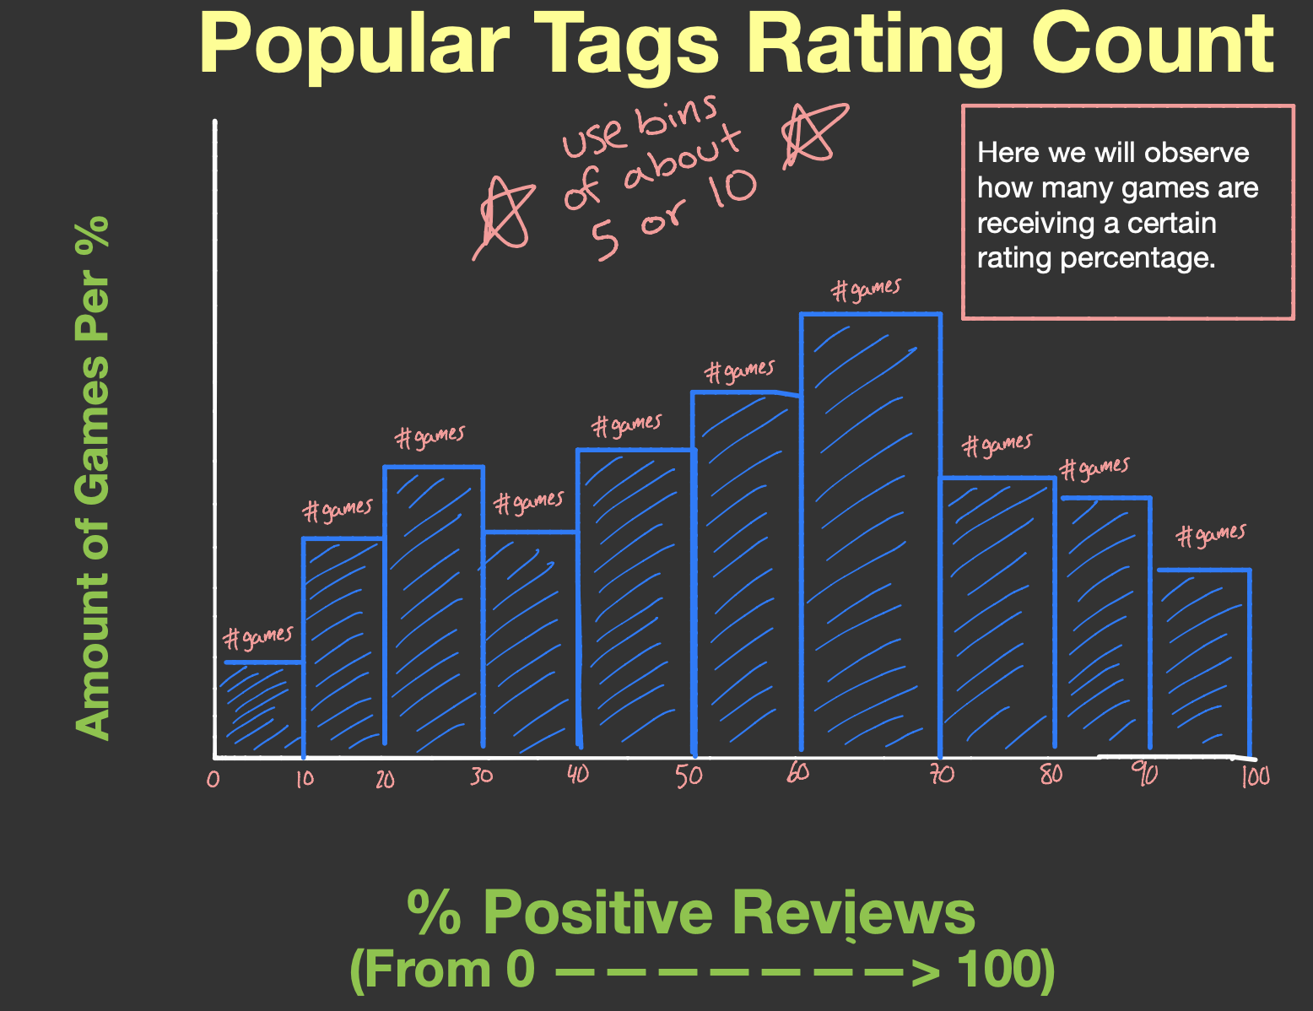
Data Analysis
By grouping the data into average ratings, we were able to determine the minimum rating to use towards our machine learning model.
This defined what was considered a “Popular Game” and which was not.
We declared a 70 minimum rating for popularity.
Notes:
Speaker Notes:
Created a histogram of the groupings of the average rating for the data set. This assisted our learning model by determining what minimum rating would be the cutoff for defining what was considered a “Popular game” and what was not based on the range given.
We based this number on the total sums, for there are amounts of players willing to play a game with an average score of 70. Anywhere below the amount begins to fall.
Found only one game with a rating of 100, which is the game [TITLE]. We considered this a weird outlier and double checked, and it indeed has a 10/10 score on Steam.

Slide 13
Data Analysis - Machine Learning
Notes:
Speaker Notes:
Need process of:
How we built our model based on our 70 cut-off
What type of model we used
What accuracy scores we got
How the model changed based on results
If the model changed further, changed markers for training
Any visuals/reports of our models and accuracy score(s)
Tools used:
Algorithms used:

Slide 14
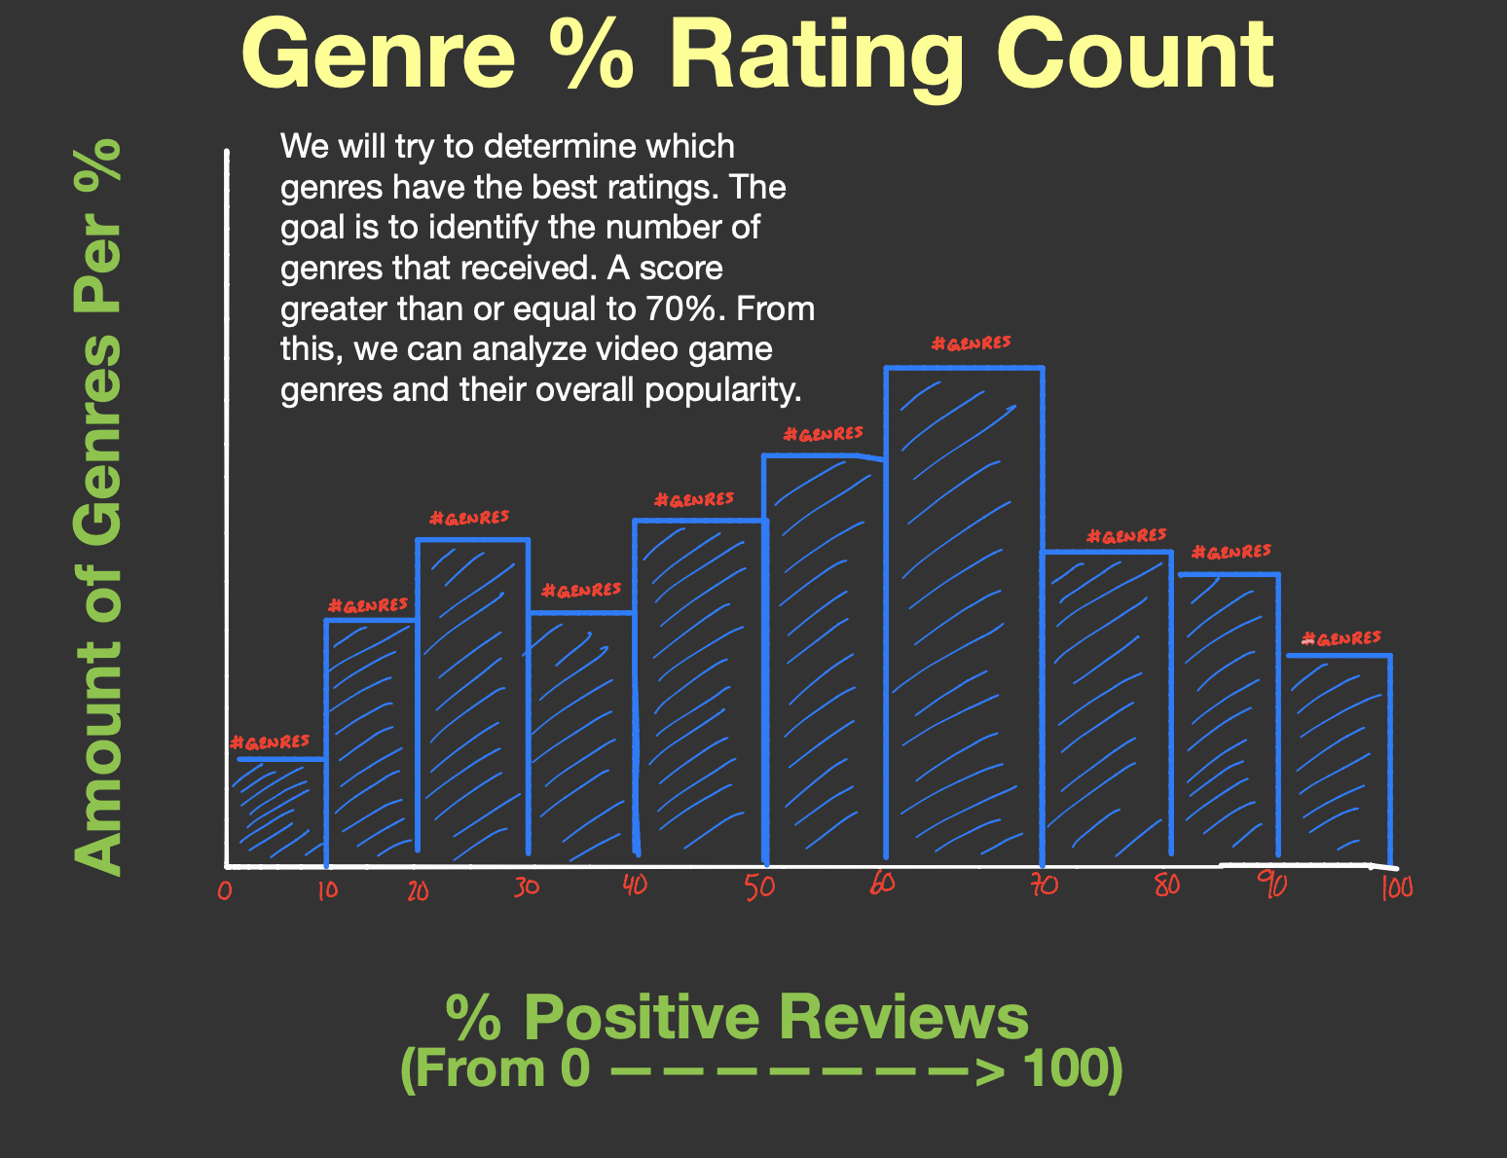
Data Analysis - Top Genres
After declaring a score of 70 or above as a popular rating, we determined which genres were the top counts.
Notes:
Speaker Notes:
After declaring a score of 70 or above as popular, we determined which genres were the top counts that were listed with the rating.

Slide 15
Data Analysis - Top Popular Tags
After declaring a score of 70 or above as a popular rating, we determined which popular tags were the top counts.
Notes:
Speaker Notes:
After declaring a score of 70 or above as popular, we determined which popular tags were the top counts that were listed with the rating.

Slide 16
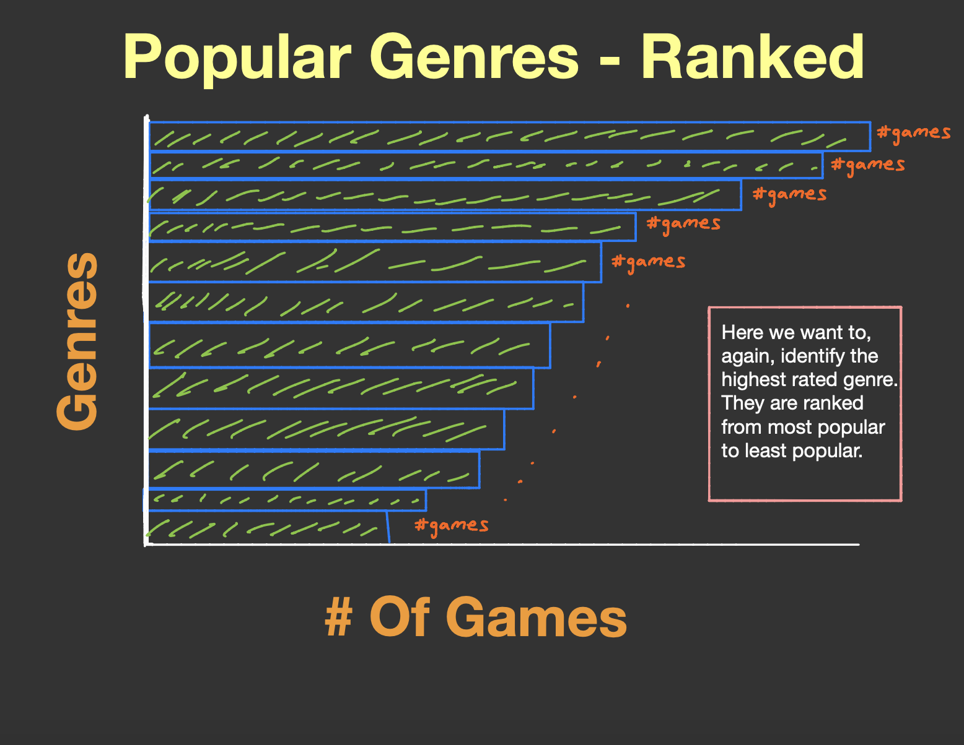
Data Analysis - Genre Ranks
Top Genres:
Item
Item
Item
Item
Item
Notes:
Speaker Notes:
Top genres, sorted by the number of games within them.

Slide 17
Data Analysis - Popular Tag Ranks
Top Popular Tags:
Item
Item
Item
Item
Item
Notes:
Speaker Notes:
Top popular tags, sorted by the number of games within them.

Slide 18
Data Analysis - Identifying Top Games
After identifying top genres and popular tags, found the specific games that fell under each category with the best ratings
Notes:
Speaker Notes:
After identifying top genres and popular tags, we located the specific games that fell under each category and sorted them based on rating.

Slide 19
Tableau Storyboard & Dashboard
Notes:
Speaker Notes:
Tableau link in title: https://public.tableau.com/profile/eva.fuentes.lopez#!/vizhome/UpComingVideoGames/Story1?publish=yes
*** Will probably remove slides 11-12 and 14-18 and cover them in the Tableau storyboard.
The

Slide 20
Results of Analysis
Final top genres/top popular tags
Top games falling under these categories
Notes:
Speaker Notes:
Final top genres/top popular tags
Top games falling under these categories

Slide 21
Recommendations for Future Analysis & Changes
Connecting our data sources using Steam's API to provide updated library results, therefore continuing to evolve our learning model and allowing a client to track any trends over time.
Expanding and including video games from other platforms.
** Machine Learning improvements:
Notes:
Speaker Notes:
Steam has open source APIs that can be accessed, can update to create a pipeline that creates weekly results, since game trends change at that pace.
Expanding our analysis to other platforms and just not PC.
Looking at other categories, like average play time or user count/ownership, or even sales.
*** What changes to the model/etc.
This concludes our presentation. We will now open for some Q & A

